Slide 1




Governance
POWER BI
Shrikesh Pattni

Slide 2
Processes are the backbone of good governance strategy that guides users on best practices
Monitoring will enable you to
react to potential problems as
well as plan preventive actions
Processes
Training
Monitoring
Roles
Training will make sure your users are using the software correctly and most efficiently
Identifying the right roles and
having them filled with the right
people will make sure you
processes work more efficiently
Shrikesh Pattni

Slide 3
Power BI: Hawk Eye View
Office 365 Governance and Security Centre
Office 365 Governance: Role Management
Power BI Tennant Governance and
Power BI Asset Management (Monitoring)
Administrator Type Related to Power BI for Office 365
Type of administrator | Administrative scope | Power BI Tasks
Global Administrator | Microsoft 365 | Has unlimited access to all management features for the organization
Billing Administrator | Microsoft 365 | Manage subscriptions
License Administrator | Microsoft 365 | Assign or remove licenses for users
User admin | Microsoft 365 | Create and manage users and groups
Power Platform Administrator | Power Platform | Full access to Power BI management tasks Enable and disable Power BI features Report on usage and performance Review and manage auditing
Power BI Administrator | Power BI service | All Same for Power Platform Administrator
Power BI Premium Capacity Administrator | A single Premium capacity | Assign workspaces to the capacity, Manage user permission to the capacity, Manage workloads to configure memory usage
Power BI Embedded Capacity Administrator | Single Embedded Capacity | All Same for Power BI Premium Capacity Administrator
Power BI Gateway Administration | Power BI Gateway | Manages user access and connection from On-Premise Data Sources to Power BI Service
Power BI Workspaces
Power BI Reports
On Prem Gateway
Data
Shrikesh Pattni

Slide 4
Power BI: Hawk Eye View
Office 365 Governance and Security Centre
Office 365 Security Centre: 90 Days Activity Logs (PowerShell/API)
Power BI Tennant Governance and
Power BI Asset Management (Monitoring)
Monitoring Tenants Management
Type of administrator | Administrative scope | Power BI Tasks
Role/Licence Access | Microsoft 365 | Must either be a global administrator or assigned the Audit Logs role in Exchange Online
Activity Logs Durations | Microsoft 365 | Keeps audit data for 90 days
Activity Logs Audit Data | Microsoft 365 | Keeps audit data, even if the tenant is moved to a different Azure region.
Activity Logs Roles for Audit Logs | Microsoft 365 | Global administrators and auditors can download audit log entries by using Microsoft 365 Management APIs and cmdlets.
Activity Logs Roles for Audit Logs | Microsoft 365 | Global administrators and auditors can search the unified audit log by using the Microsoft 365 Defender portal and the Microsoft Purview compliance portal.
Activity Logs Roles for Audit Logs | Microsoft 365 | Power BI administrators can analyse usage for all Power BI resources at the tenant level by using custom reports that are based on the Power BI activity log
Activity Logs/Events REST API | Microsoft 365 | You can use an administrative application based on the Power BI REST APIs to export activity events into a blob store or SQL database. You can then build a custom usage report on top of the exported data
Activity Logs/Events Get-Power BIActivity (PowerShell) | Microsoft 365 | Download activity events by using Management cmdlets PowerShell. The Get-PowerBIActivityEvent fromStartDateTime and an EndDateTime
Access your audit logs | Power BI Service | Audit and usage settings in the admin portal. There may be up to a 48-hour delay between the time you enable auditing and when you can view audit data
Power BI Workspaces
Power BI Reports
On Prem Gateway
Data
Shrikesh Pattni

Slide 5
Power BI: Hawk Eye View
Office 365 Governance and Security Centre
Powe BI Tennant Governance
Power BI Tennant Governance and
Power BI Asset Management (Monitoring)
Tenants Administration Settings to understand an implement
Type of administrator | Administrative scope | Power BI Tasks
Usage metrics | Power BI Service | are an overview of the most popular artifacts in your tenant. Not possible to change
Users |  | are not part of the Power BI Administrator role
Dataflows settings |  | Assign or remove licenses for users
Audit logs |  | are the basis of a good monitoring strategy
Tenant settings |  | is where the most important settings are
Capacity settings |  | allow the administrator to manage capacities if the tenant has Power BI Premium subscription
Embed codes |  | allow the administration to have an overview over what embed codes (including publish to web) are being used
Organizational visuals |  | allow the administrator to manage custom visuals in the organizations' own internal store
Azure connections |  | is where the administrator can add the organization own data lake storage to store data flows in
Workspaces |  | is where the administrator can see all workspaces and manage modern workspaces
Protection metrics |  | is where the administrator can see metrics about the Power BI sensitivity labels if turned on
Export and sharing | Power BI service | Common sense – TURN OFF “publish to web”
Power BI Workspaces
Power BI Reports
On Prem Gateway
Data
Shrikesh Pattni

Slide 6
Power BI: Hawk Eye View
Office 365 Governance and Security Centre
Powe BI Asset Management (Monitoring)
Power BI Tennant Governance and
Power BI Asset Management (Monitoring)
Power BI Service Asset Management
Type of administrator | Administrative scope | Power BI Tasks
Role/Licence Access | Microsoft 365 | Must either be a global administrator or assigned the Audit Logs role in Exchange Online
Power BI Workspaces
Power BI Reports
On Prem Gateway
Data
Shrikesh Pattni

Slide 7
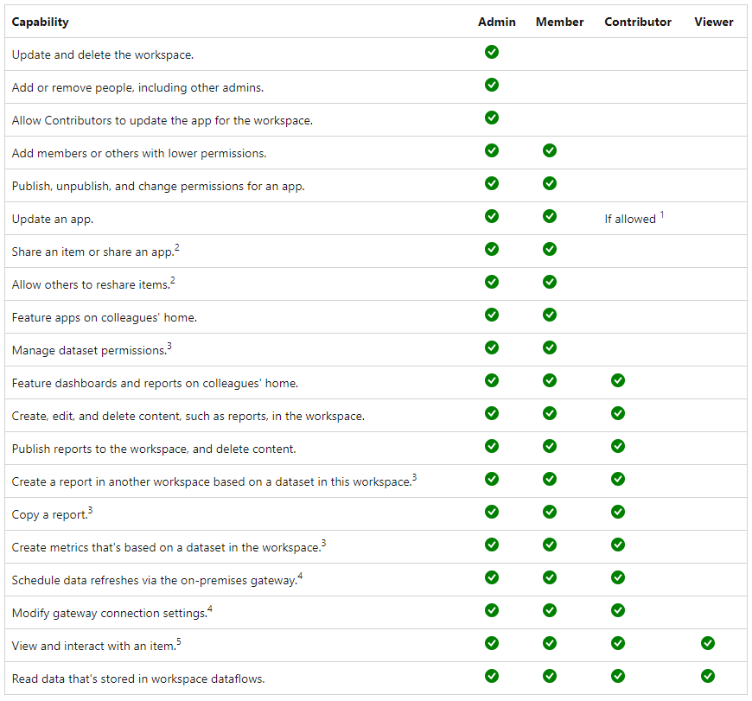
Power BI: Hawk Eye View
Office 365 Governance and Security Centre
Power BI Workspace – Defined Roles Governance (Part 1)
Power BI Tennant Governance and
Power BI Asset Management (Monitoring)
Power BI Workspaces
Power BI Reports
On Prem Gateway
Data Hygiene/Ops
Data
Shrikesh Pattni

